Slide 1

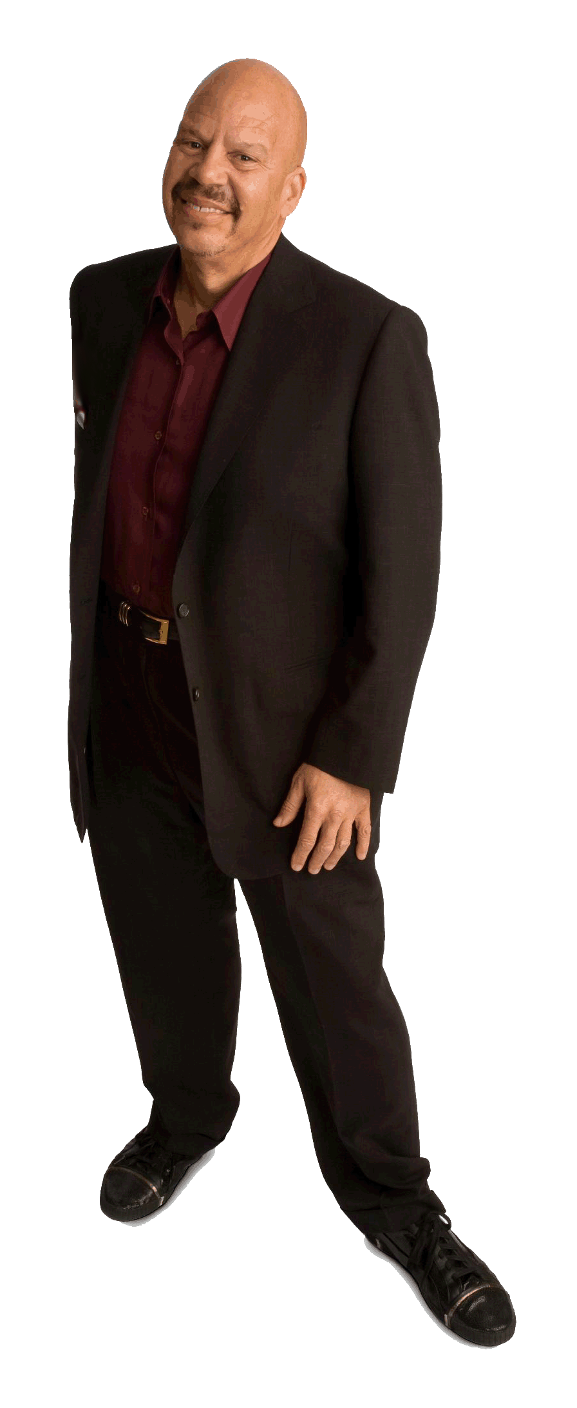

(YOUR LOGO HERE)
Featuring
The Tom Joyner Morning Show
RADIO | INTERNET | EVENT MARKETING | SOCIAL MEDIA
1
4
REACHING
ADULT
AFRICAN
AMERICANS
IN
Tom Joyner is influential, inspirational, and dynamic. His four-hour,
drive-time radio show offers a daily dose of information, entertainment
and empowerment to his audience of 8 million adults in 105 markets.
Joyner compliments his extensive reach with internet and event marketing.
You can hear Tom Joyner here at (your station call letters, dial position,
web info).

Slide 2

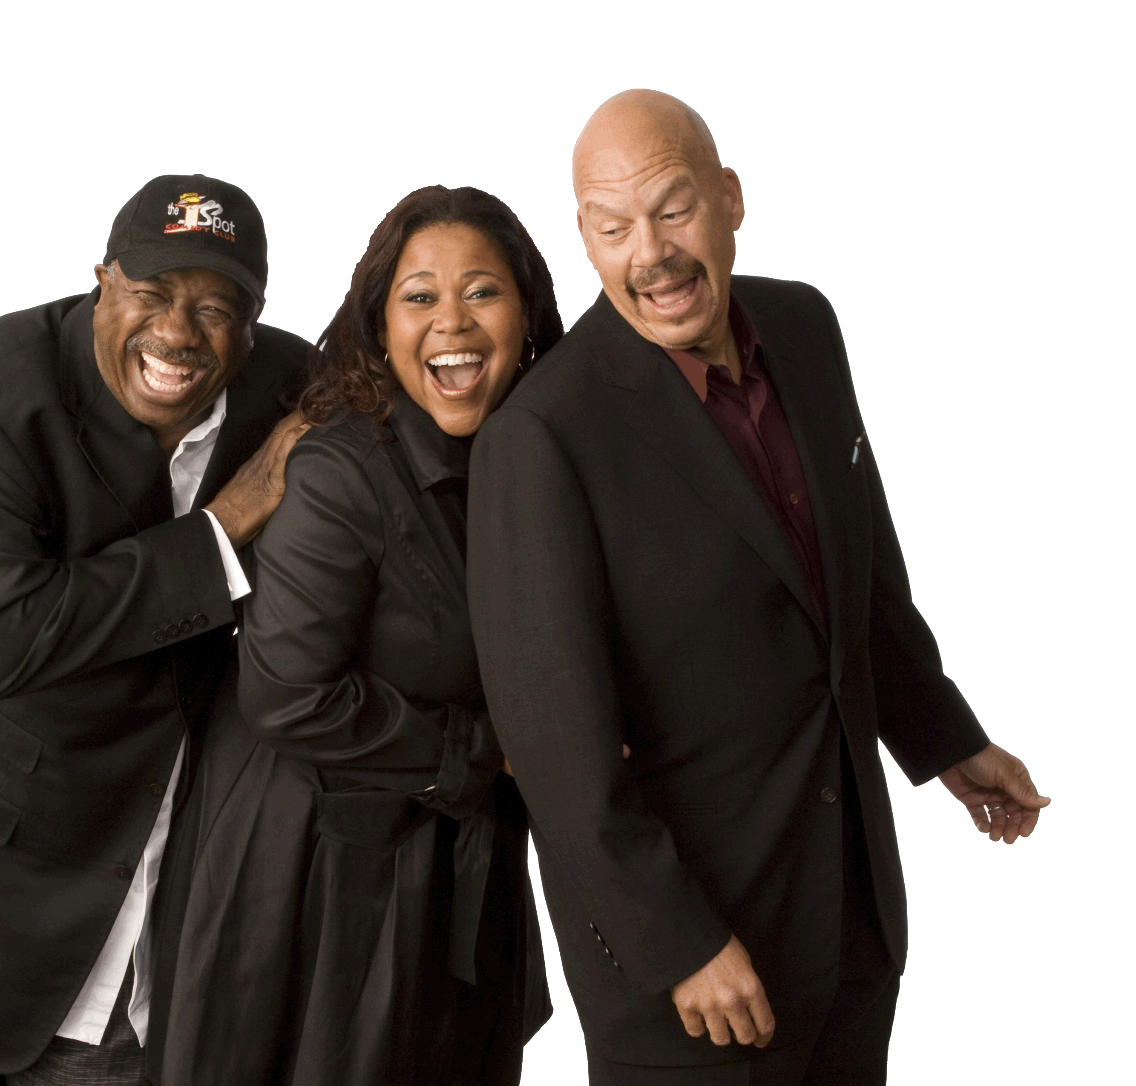
TOM JOYNER CONNECTS WITH LISTENERS
Tom Joyner is known for his down-to-earth, ‘keepin’ it real’ personality with a star-studded cast of entertaining leaders that has attracted an intensely dedicated, responsive audience of listeners with blue-chip advertisers.
TOM JOYNER SHOW FEATURES
Tom’s stories about real listeners rate high with his audience.
Real Fathers, Real Men
Recognition of a man taking charge in his community and with children
Thursday Morning Moms
Recognition of mothers and women impacting their family and community
Celebrity Snitch/Huggy Lowdown
Humor to the “unbelievable” as it relates to celebrities
Christmas Wish
Tom grants support financially or with a connection to people making a difference in the community
Little Known Black History Facts
Highly rated feature celebrating Black culture and the stories that go with it
BlackAmericaWeb.com Headlines
Daily news reports of stories relevant to the community with more details on the website
Steve Silk Hurley Old School/New School Mix
A smooth mix by a master DJ that’s relevant to that day
What in the Weekend with Nikki Woods
A Tom Joyner Morning Show perspective on personal and family entertainment
Get Well Wednesday
Specialists field medical questions relevant to the audience that supports Tom's focus on wellness and awareness
J ANTHONY BROWN
Making us laugh while Tom helps explain what’s happening
SYBIL WILKES
Connecting with listeners, delivering facts and information with positivity
TOM JOYNER
The Man who brings it all together

Slide 3

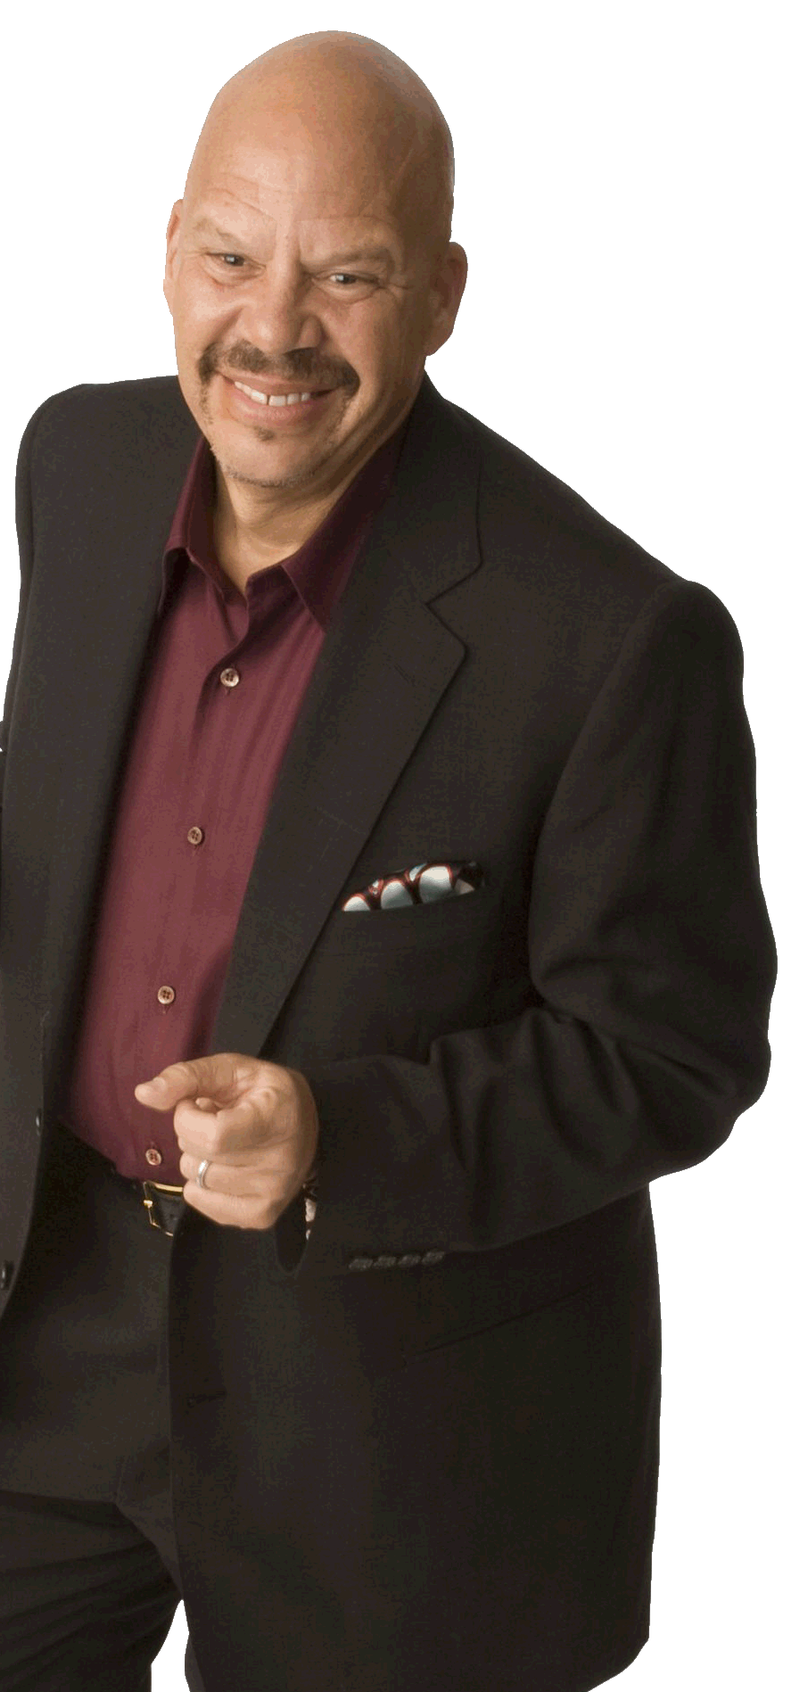




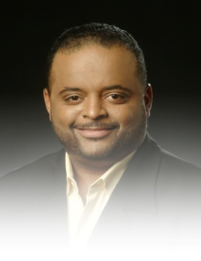
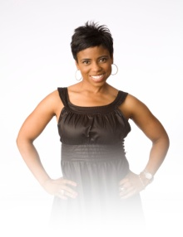
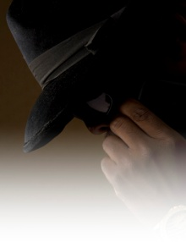
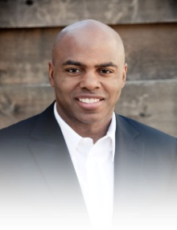
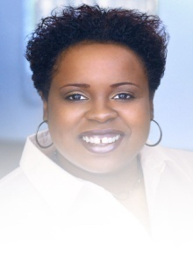
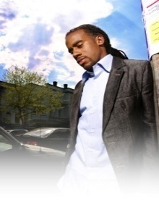
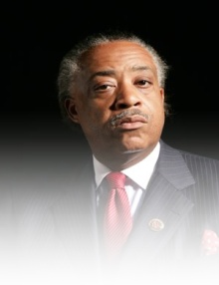
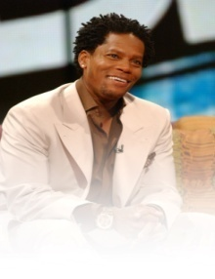
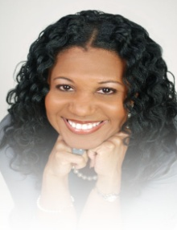
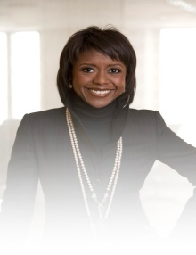
Initiatives that Reach a Loyal Audience Personally
Family/Lifestyle
Health
Education
Lifestyle / Education
Education
The Tom Joyner Family Reunion
Labor Day weekend event at Orlando theme parks/venue that attracts an estimated 14,000 guests with fun, fellowship and entertainment for the whole family.
Tom Joyner’s Take a Loved One to the Doctor Season
A call to action, to improve health care among minority groups, especially African-Americans to encourage a friend, neighbor or family member to get a check-up.
Tom Joyner’s Back to School
Tens of thousands attend in Tom Joyner Morning Show markets and highlight the return of school for all ages.
Tom Joyner Foundation Fantastic Voyage®
As many as 4,000 guests, raising $1 million for Historically Black Colleges and Universities. A floating “Party with a Purpose®” with non-stop entertainment benefiting the Tom Joyner Foundation.
The Tom Joyner Foundation
Raises and donates money to Historically Black Colleges and Universities in the U.S. $55 million raised to support 14,500 students.
Roland
Martin
Commentary
M-F 6:16am ET
Jacque Reid
Inside Her Story
M-F 7:16am ET
Huggy
Lowdown
Celebrity Snitch
M-F 7:30am ET
Kevin Frazier
Entertainment Report
Tue 6:50am ET
Dominique
M /W 8:16am ET
F 5:16/5:32am ET
Jeff Johnson
Commentary
Tue 8:16am ET
Reverend
Al Sharpton
Commentary
Wed 7:16 ET
D.L.
Hughley
Commentary
Fri 8:16am ET
Stephanie
Robinson
Commentary
Thu 8:16am ET
Mellody Hobson
Money Mondays
Mon 6am ET

